Slide 1

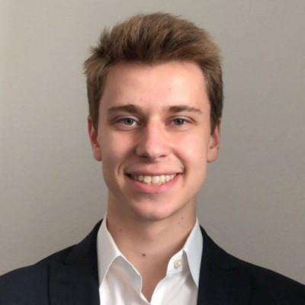
Tidal Hackathon Presentation
TIDAL TAMU DATATHON!!!!!!

Slide 2
Tidal Hackathon Presentation

Slide 3
The problem:
Finding a way to strengthen student-teacher engagement to ensure students succeed.

Slide 4
Our solution
Develop an application that will predict whether a student will require 1-on-1 tutoring or not, depending on our model’s prediction of a final exam score.

Slide 5
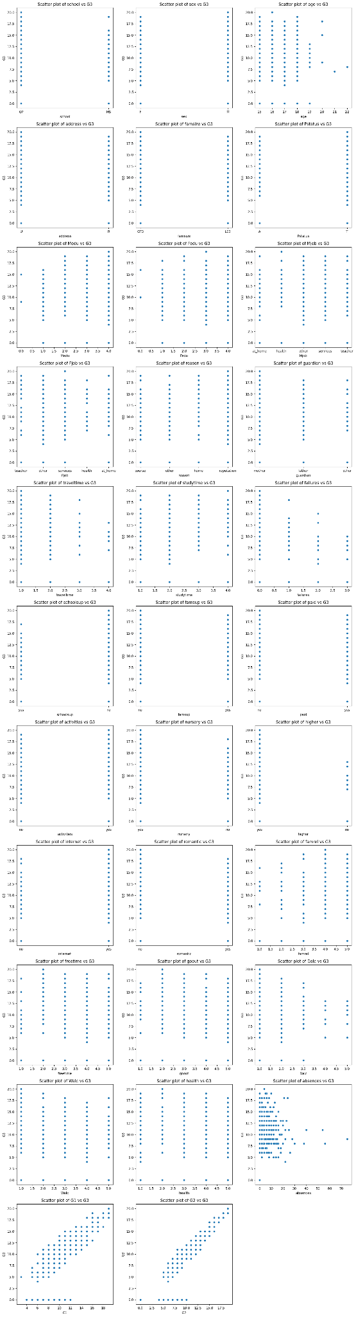
Step 1: What are we working with?

Slide 6
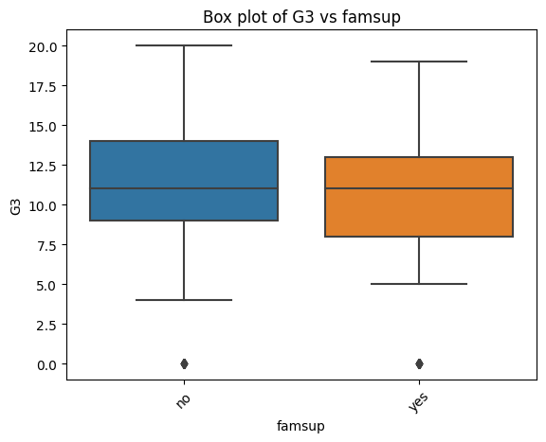

Slide 7
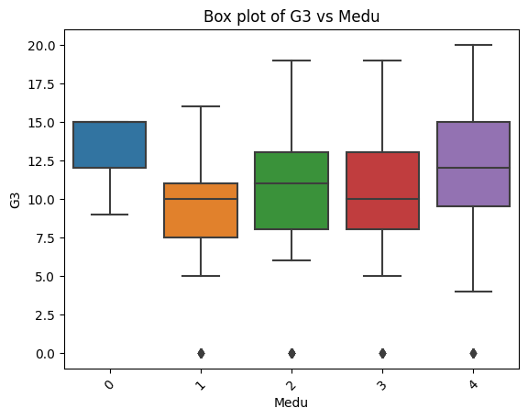
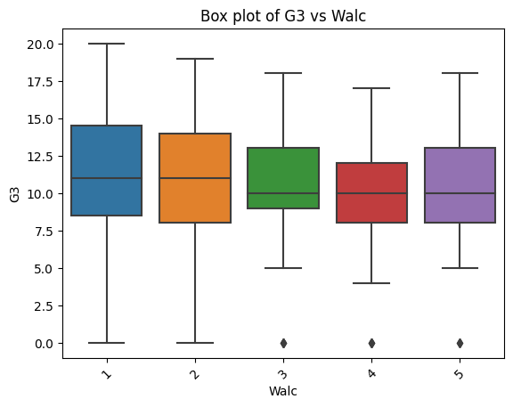

Slide 8
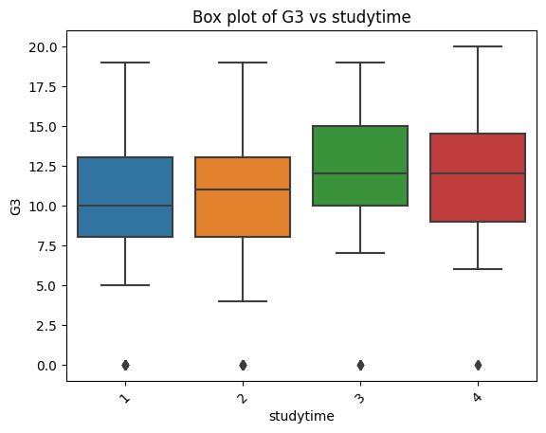
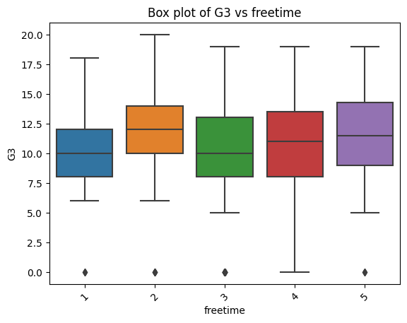

Slide 9
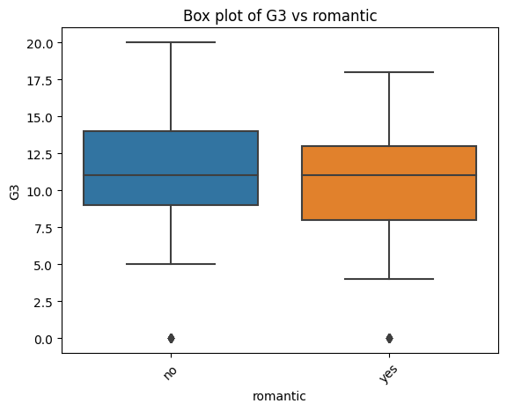
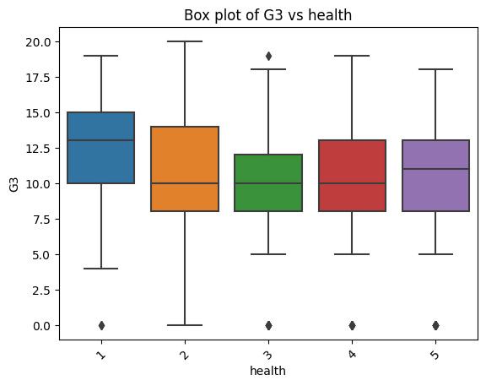

Slide 10
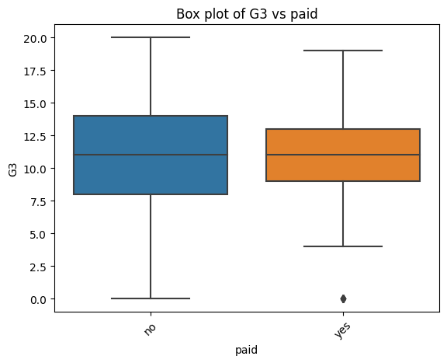
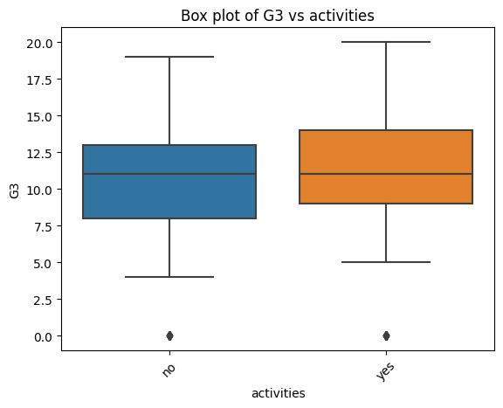

Slide 11
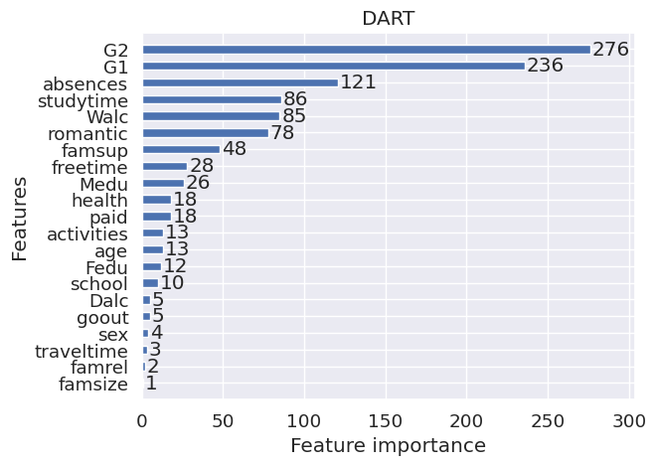
Obtaining Feature Importances

Slide 12
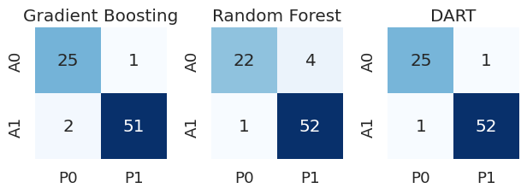
Testing our hypotheses

